Slide 1
Make for World
NIRMAL AUTOTECH INDUSTRIES PVT. LTD
(AN IATF16949:2016 CERTIFIED COMPANY)

Slide 3
About Us
NIRMAL AUTOTECH INDUSTRIES PVT LTD, is an IATF16949 : 2016 certified company, an exporter as well as domestic supplier of various types of Turning components, various types of Precision Turning components & Fasteners of alloy steel and stainless steel, was established in 2008 with the vision to make available all the world class turned components. Our target is to achieve the desired quality along with the optimum cost and packaging as per customer requirements and to meet other service requirements of Logistics as well. The Company has a young experienced, dedicated, energetic and qualified team with a total manpower of 70 personnel having a covered area of 15,000 sq. feet.

Slide 4
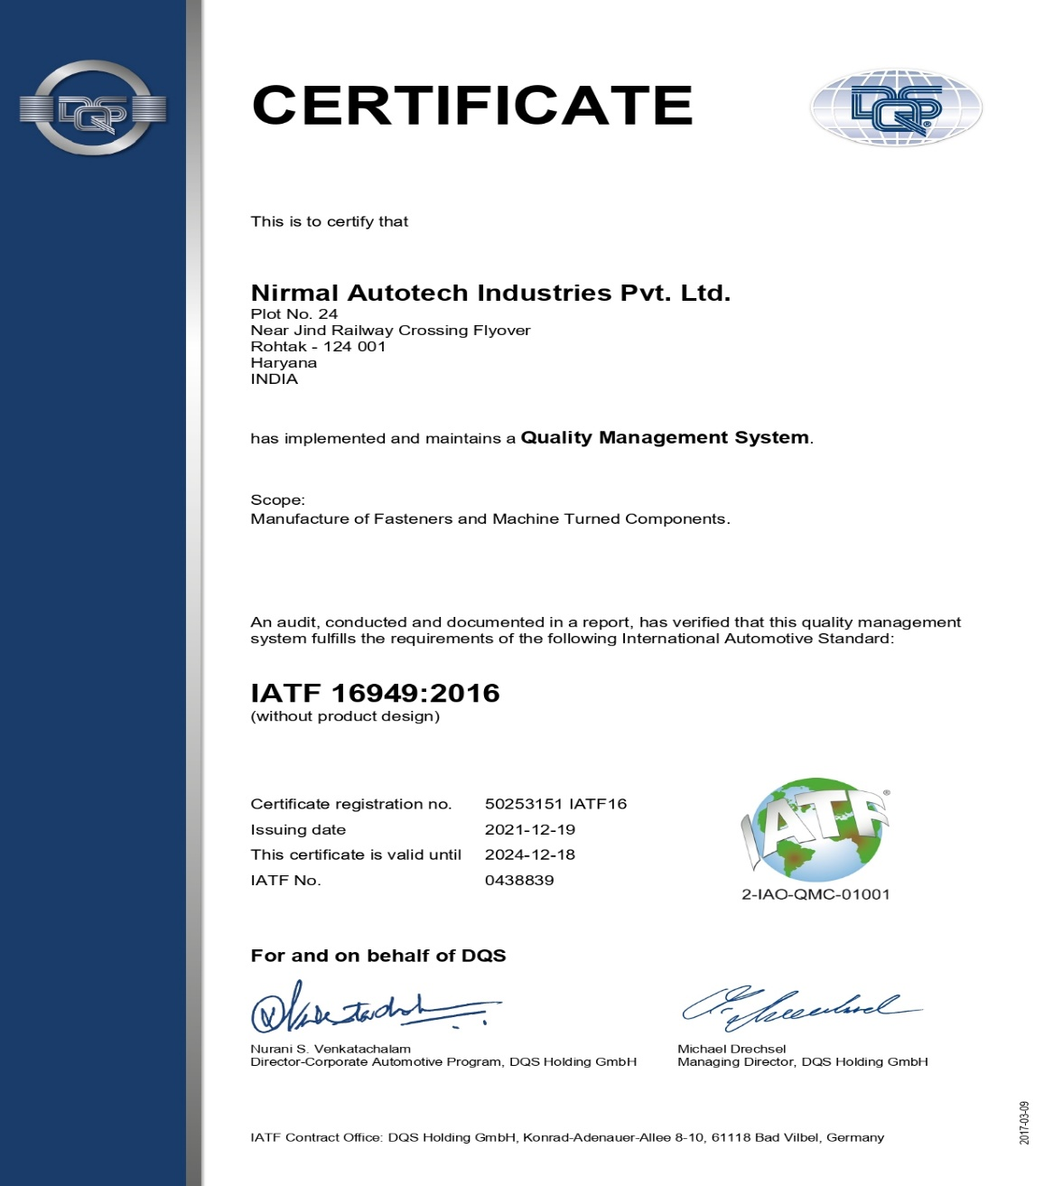
IATF Certificate

Slide 5
Quality Policy
We at Nirmal Autotech Industries (P) Ltd. are committed to enhance customer satisfaction by consistently providing excellence in Quality, Cost, Delivery & Development through continual improvement of the Quality Management System Performance.

Slide 6
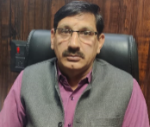
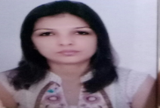
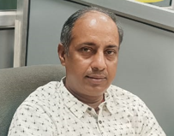
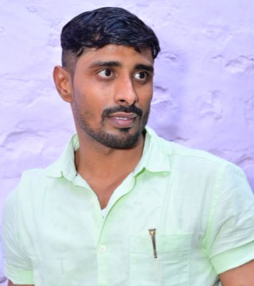
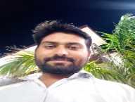
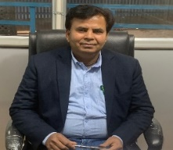
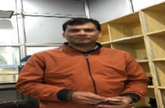
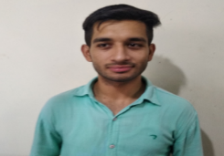
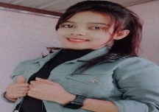
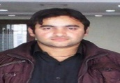
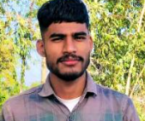
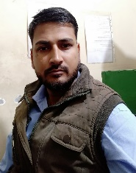
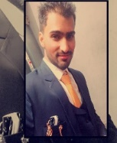
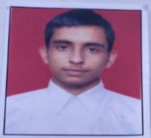
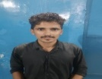
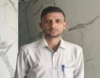
ORGANISATION STRUCTURE
REF. F16HR01
Rev. -00-13.3.18
DIRECTOR
ISHWAR HOODA
CEO & MD
VIRENDER HOODA
ADMIN HEAD
SUNITA HOODA
PLANT HEAD
Sanjay Bhatia
QUALITY HEAD
ANURUDDH SINGH
NPD HEAD
SUNIL
MANAGER (SCM)
JITENDRA
ACCOUNTS
RAMAN
HR
VERSHA
OPERATIONS HEAD
BIJENDER KATARIA
SENIOR ENGINEER ( PPC)
DEVENDER
NPD DESIGNER
Vivek saini
FINAL INSPECTION
ATUL
INPROCESS
AJAY
Incoming
DEEPAK
PRODUCTION
ANOOP
PRODUCTION
KRISHAN

Slide 7
Company Milestones
Foundation of Nirmal Autotech with 4 traub machines &2 Drill machines with 10 Man power
Added 5 more Traub Machine&3 drill machines with 40 manpower
Added 1 Traub machine &1drill machine &2centerless grinders with 50 manpower
Added machine Added 1 Traub machine & 2 capstan lathe
Nirmal Autotech. Another Plant inaugurated named as M/s S.V.Precesion in Rohtak
Added 4 traub machine & 3 drill machines with 30 Man power
2008
2009
2010
2011
2012
2013
Nirmal Autotech Industries changed as Nirmal Autotech Pvt. Ltd
Added 2 CNC Machines &
2 Traub Machines capacity of 60 & 42 Dia.
Added 3 more CNC Machines one more plant set up named as M/S Nirmal Shiners
#First consignment delivered at Global level
Approved Green Supplier from Maruti Suzuki India Ltd
Approved by IATF16949:2016
Added new TSUGAMI
B0205-III
Machine
2014
2015
2016
2017
2018
2019

Slide 8
Company Milestones
Added 2 milling m/c & 2 power press
Plant Upgrade
Added 2 T sugami M/C, 1 CLG, 1 Header ,1Rolling,
,1 Lathe
Added...
1. Add Optical Shorting Machine.
2. Add Ultrasonic cleaning Machine 3. Spectro ( chemical testing machine)
Added...
1. Add part farmer.
2. Add Optical shorting machine 01
3. Add 10 nos. traub machine
2020
2021
2022
2023

Slide 9
Vision:
Increase the turnover by 200% with adopt world class manufacturing facilities and processes, build core-competencies in employees, pursue zero defect , ensure on time deliveries, maintain a safe, clean and inclusive environment, thereby ensuring customer satisfaction
Mission:
Be a preferred global supplier for a diversified range of specialty high-tech components & assemblies, serving multiple sectors and customers, with a win-win approach for all
stakeholders
Core Values:
Sense of Urgency
Customer Obsession
Think Big, Innovated, then Simplify
Ownership & Empowerment
Excellence as a Way of life

Slide 10
Valuable Customers

Slide 11
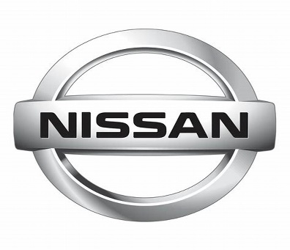
We are approved TIER-II source for MARUTI SUZUKI, RENO NISSAN, GENERAL MOTORS, MAHINDRA& MAHINDRA..
Our esteemed customers SOGEFI MNR& KONSBERG DRIVLINE SYSTEMS &OPTIMAS Approved us in VDA 6.3 our score is above 90%..
We are Green Certified supplier for MSIL

Slide 12
Sales Turnover

Slide 13
Strengths:
In House capability for development of all type of Turning components
Low development Cycle time
Quick response to change in Design
Experienced Technical Promoters
Quick response to customer
Excellent Quality on competitive cost

Slide 14
Products
We are making custom-made products made purely from bar stock which requires various secondary operations of Parting, Machining/Turning, Grooving, Milling and Grinding. With our machining capabilities we are able to control the process parameters with 0.05 mm and with our grinding capabilities we are able to control the process parameters within 0.005 mm and taper ovality can be controlled within 0.005 mm. We also honor the jobs which, after machining, require surface finishing i.e. Alkaline Zinc Plating & Acid Zinc Plating (White, Blue, Silver, Yellow, Black and Green). Plating facility is available in our sister company of Nirmal Shiners.

Slide 15
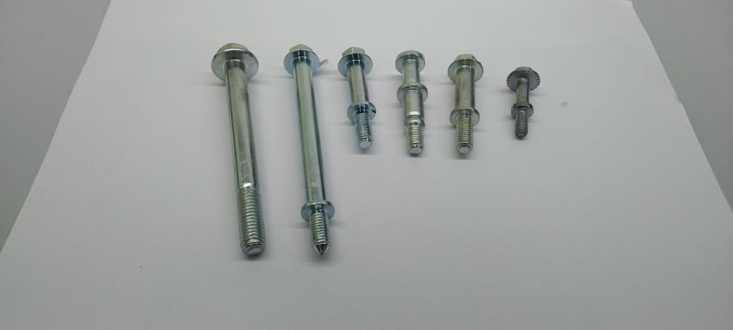
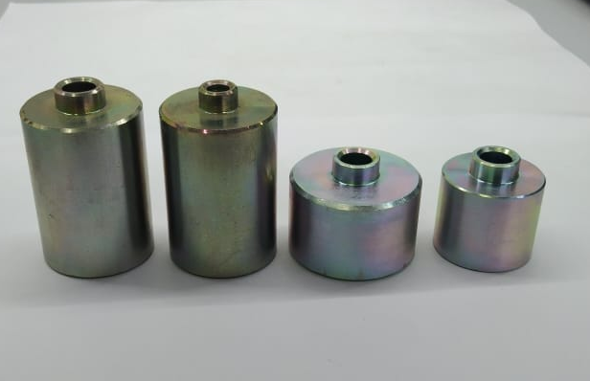

Slide 18
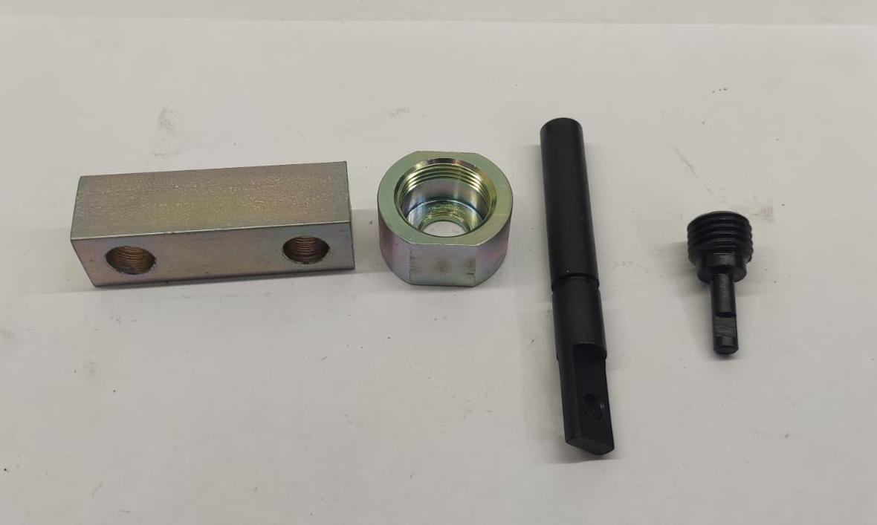

Slide 21
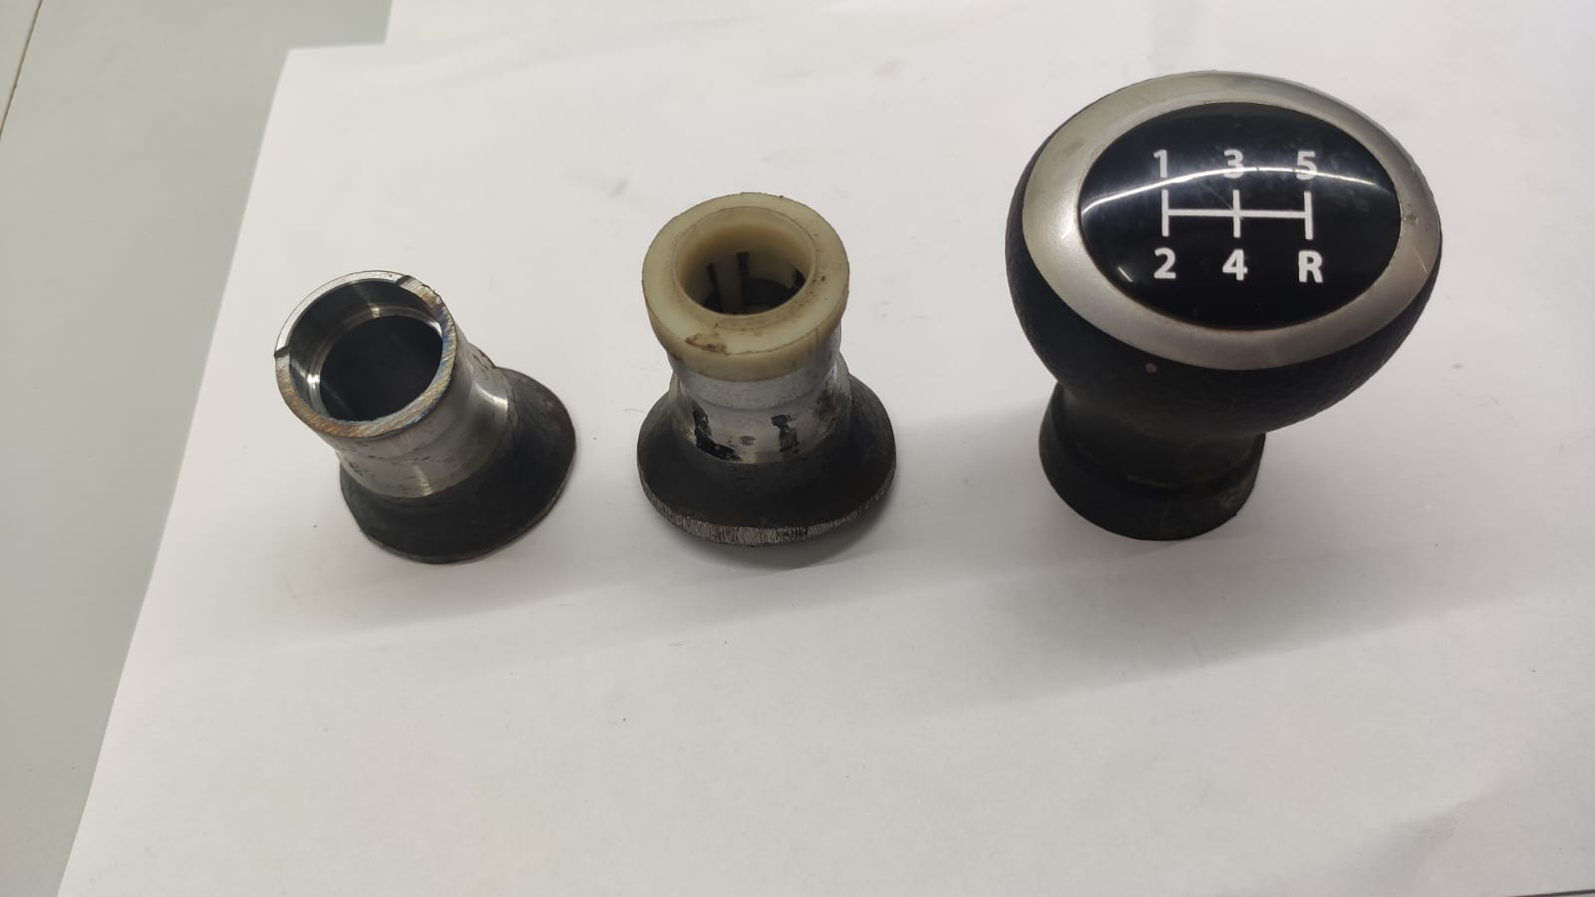

Slide 22
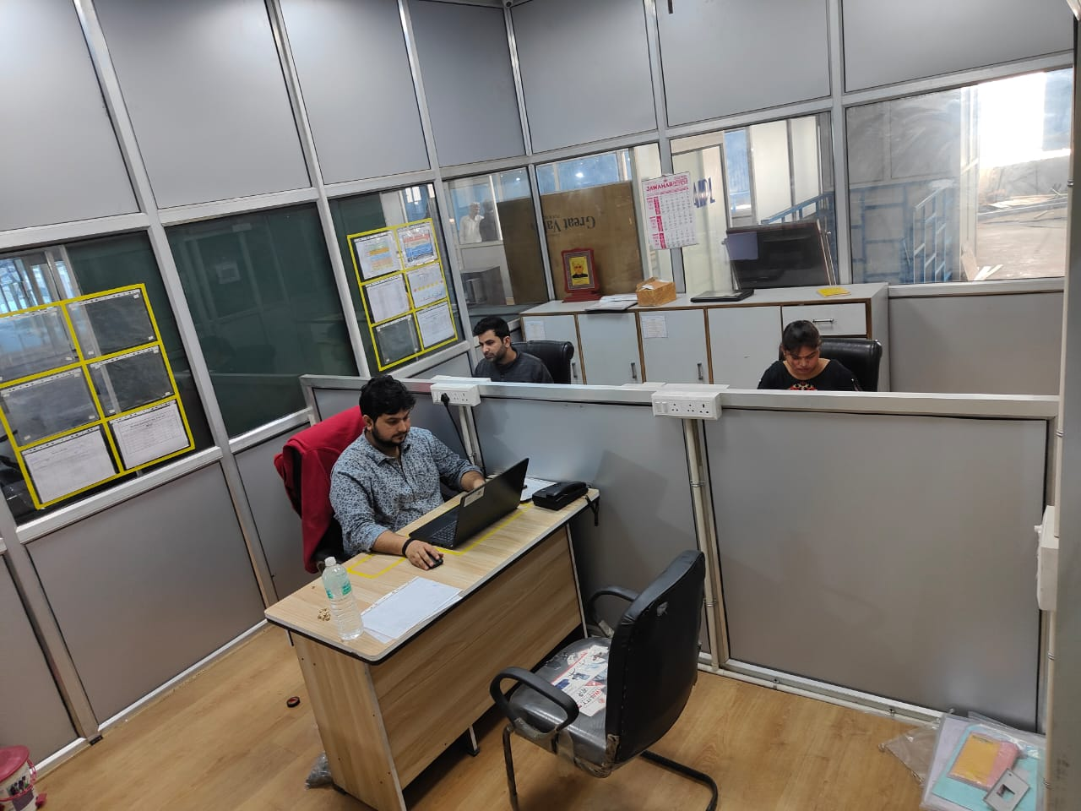
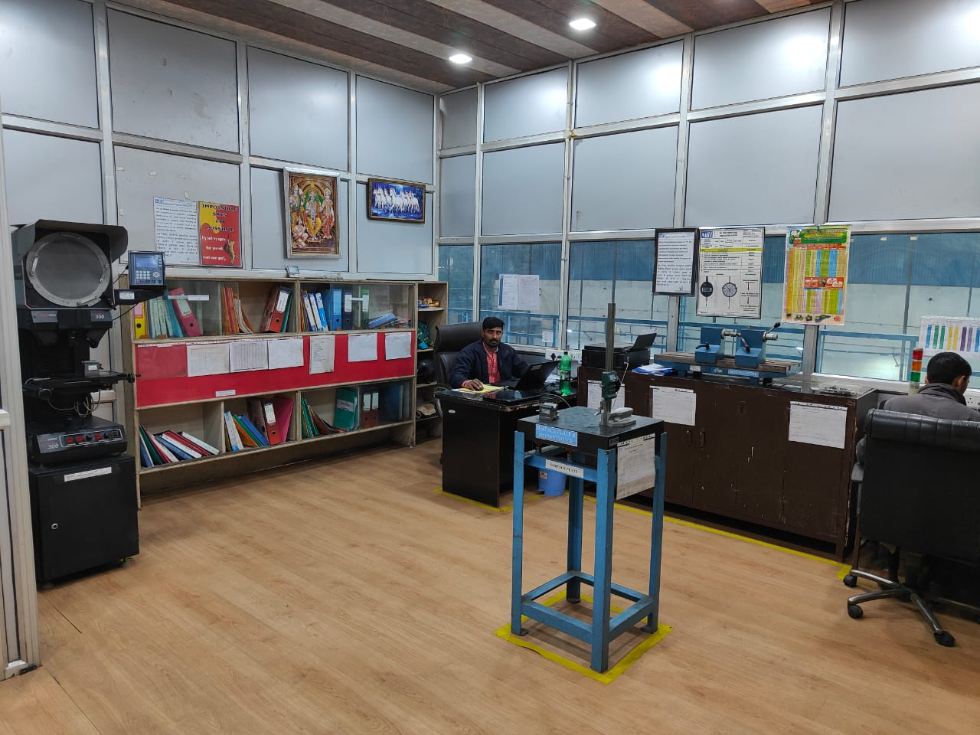
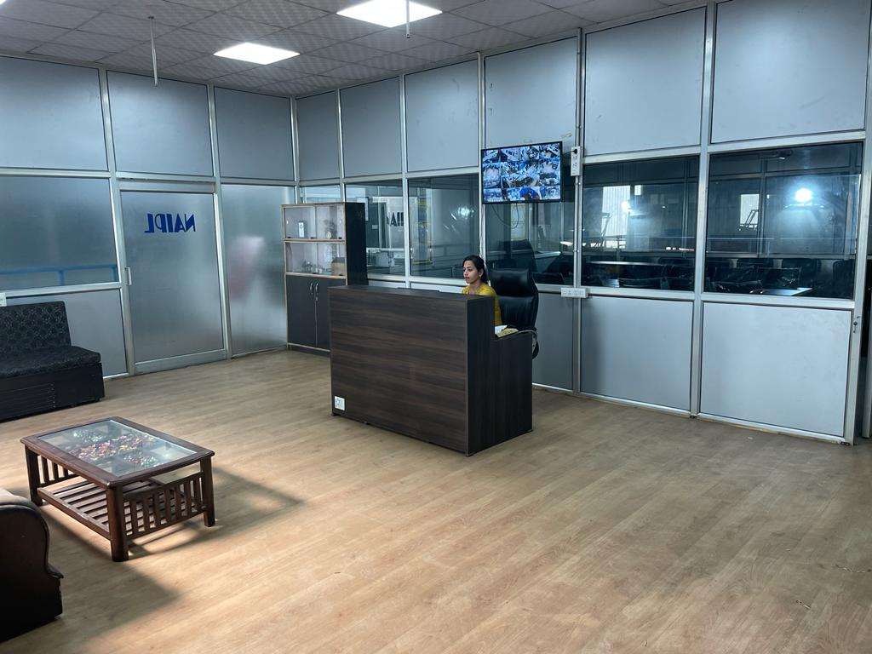
NPD Section
Standard Room
Reception
PPC Office

Slide 23
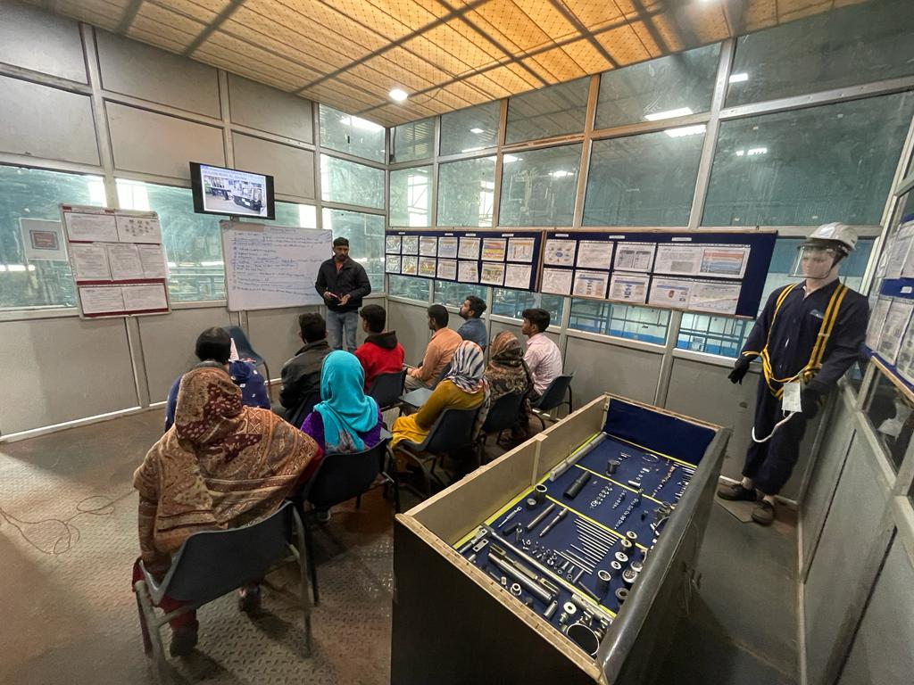
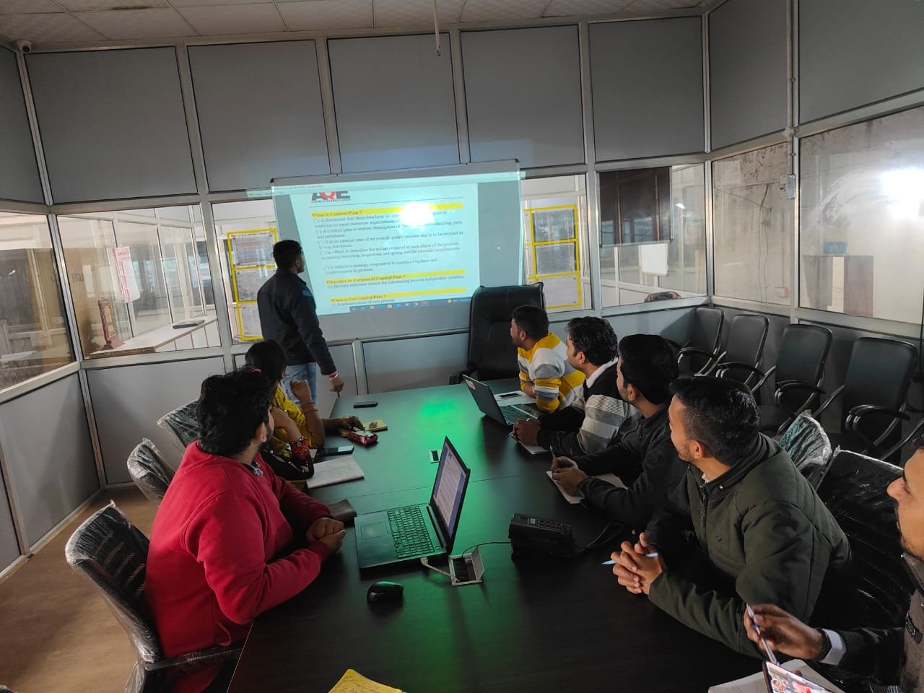
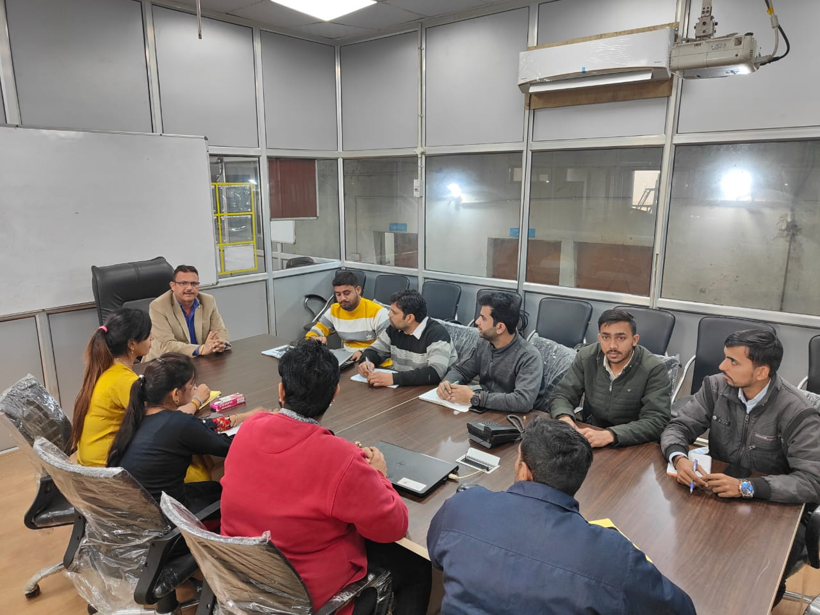
Dozo Room And Daily morning meeting area
Conference room

Slide 24
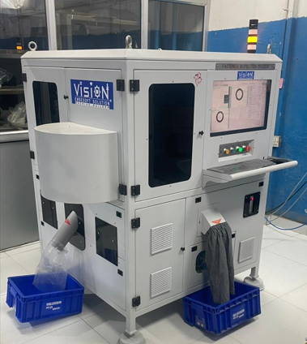
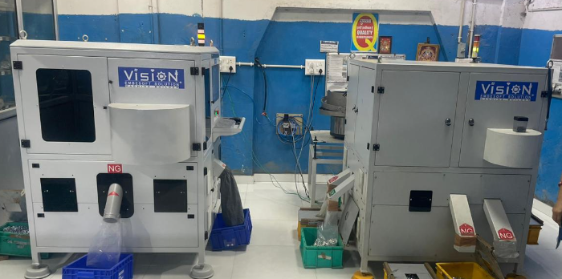
Optical Sorting Machine 2nos.

Slide 25
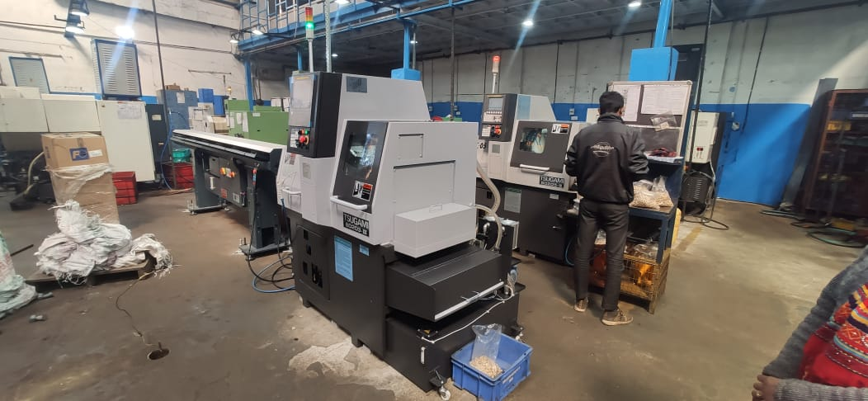
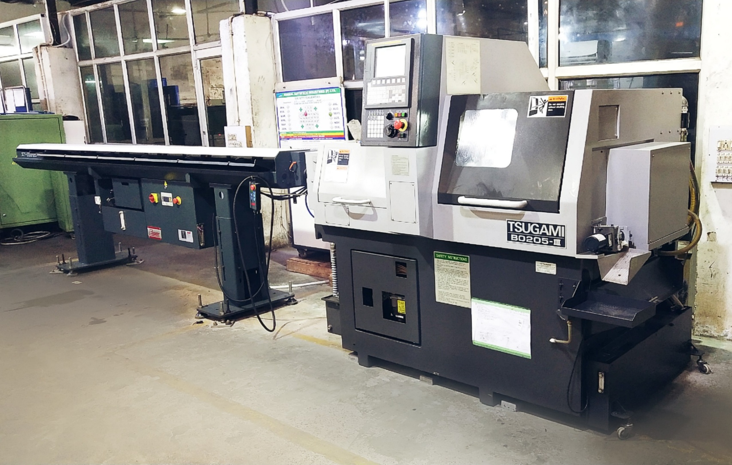
TSUGAMI B0203 –III & B0205-III Machine

Slide 26
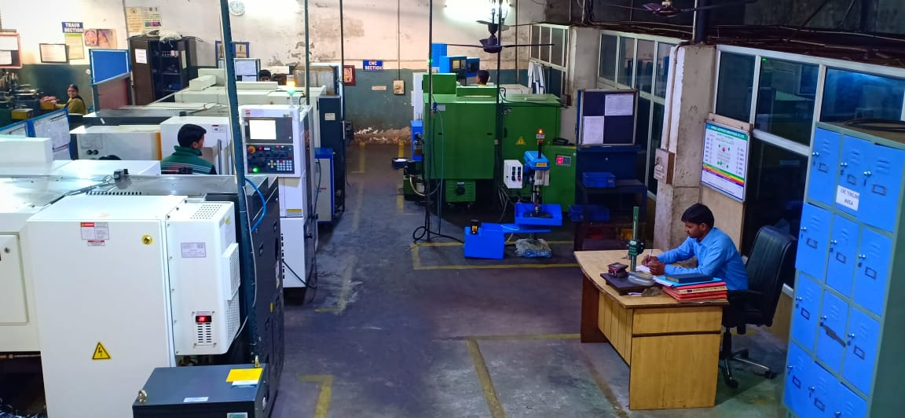
CNC Section

Slide 27
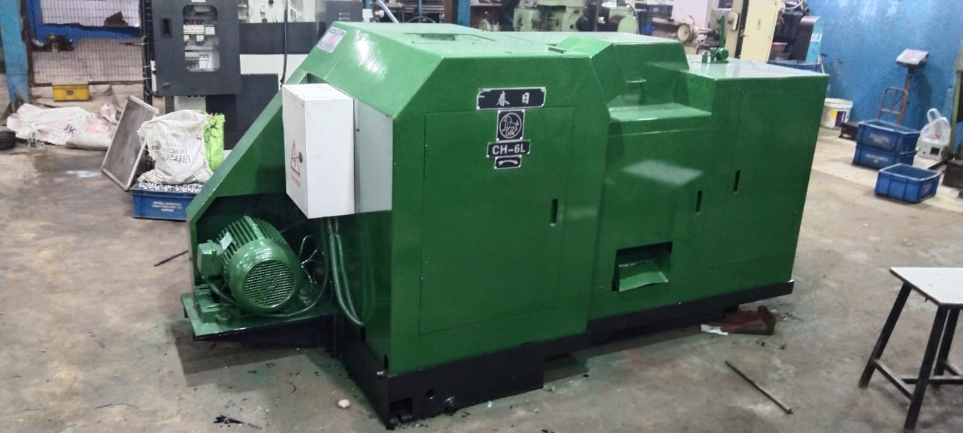
Cold Forging (M4 To M10):
Rolling Machine:

Slide 28
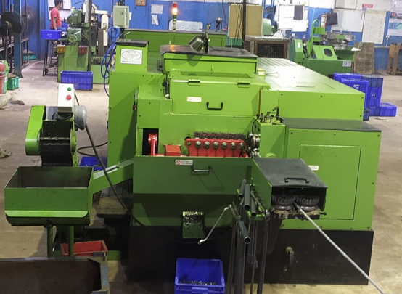
Cold Forging Part farmer 14B 7 station (1/2 inch):

Slide 29
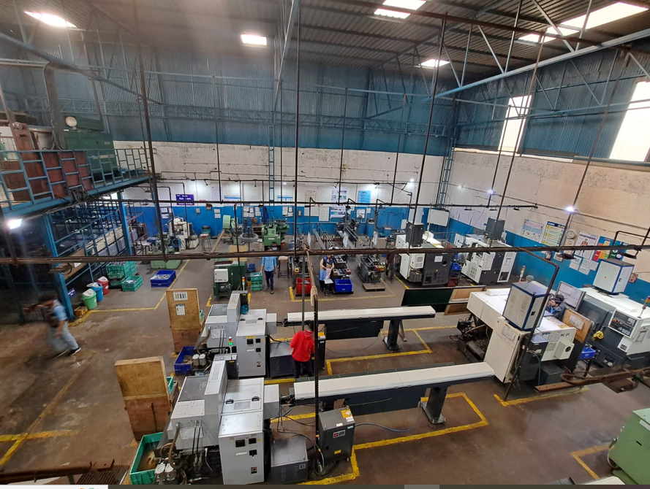
Machining Area :

Slide 30
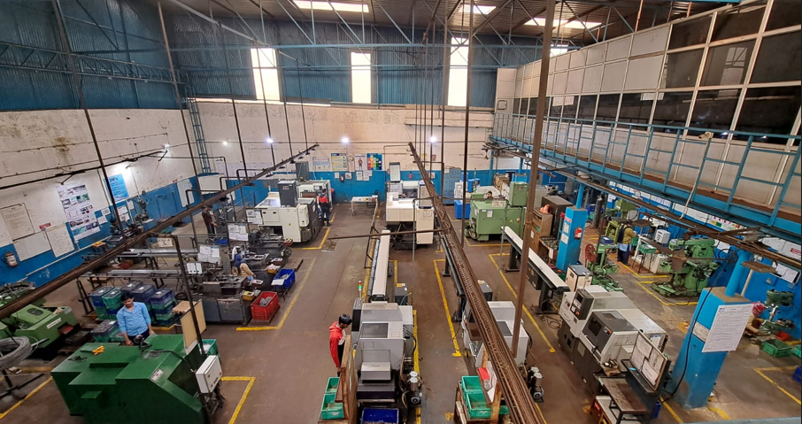
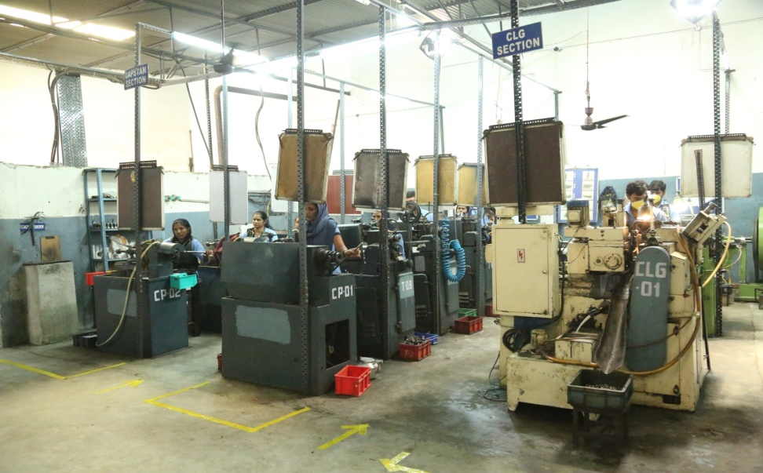
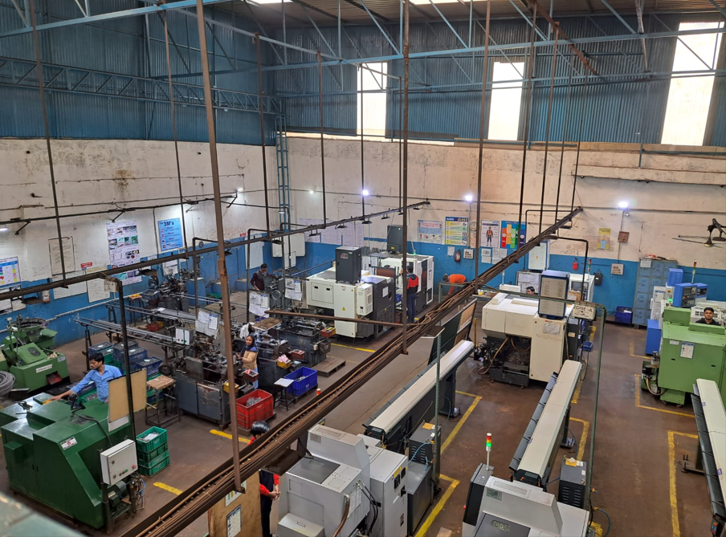
Troub & Capstan Section

Slide 31
List of Machineries
CNC Turning center.
Traub machine capacity up to Dia. 60 mm.
Traub machine capacity up to Dia. 42 mm.
Traub machine capacity up to Dia. 38 mm.
Traub machine capacity up to Dia. 32 mm.
Traub machine capacity up to Dia. 25 mm.
Capstan Turning Lathe.
Centre less Grinder.
Drilling M/c.
Tapping M/c.
Thread Rolling M/c.
Hydraulic Power Press M/c. 10T & 50T

Slide 32
List of Machineries
m) Power Hacksaw
n) Milling Machine
o) Furnace M/c.
p) T Sugami 5Axis
q) Laser Marking M/c.
r) Optical Sorting machine.
s) Hydraulic Centre less Grinding.
t) Cold Forging (M4 to M10)
u) Hot forging.
v) T Sugami 3 Axis.
W ) Ultrasonic cleaning Machine
X) Spectro ( Chemical Testing Machine )
X1) Part farmer

Slide 33
QUALITY ASSURANCE
All our products are manufactured under stringent control processes and methods. Quality has become an integrated part of the company culture and the quality systems used are in compliance with the best standards of the world. Our expert technicians monitor the production process daily to ensure high quality international standards. We use the raw material of the best quality and adopt strict quality control methods, supervised by a well educated and technically qualified engineers at all stages of manufacturing right to the dispatch of the product.
WE STRIVE FOR ZERO % REJECTION PPM AT CUSTOMER’S END AND AIM FOR 100% DELIVERY RATING.

Slide 34
List of Instruments Mfg. Plant
Profile Projector.
Hardness Tester.
Height Gauge.
Plating Thickness Tester.
Roughness Tester.
Surface Plate.
Air Pressure Gage Unit.
Dial Bore Gage. ( 6-35mm)
Angle Protractor.
Plunger Dial.
Puppy Dial.
Inside-Outside Spring Caliper.
Pitch Micrometer.
Digital Micrometer. ( 0-50mm)
Digital Vernier Caliper (0-300mm)
Outside Micrometer.
Eddy Current Sorting Machine.
3Pin wire set
Lux Meter
Noise Meter
Bench Center
Slip Gauge
Optical Shorting
Spectro ( Chemical Testing M/c.)

Slide 35
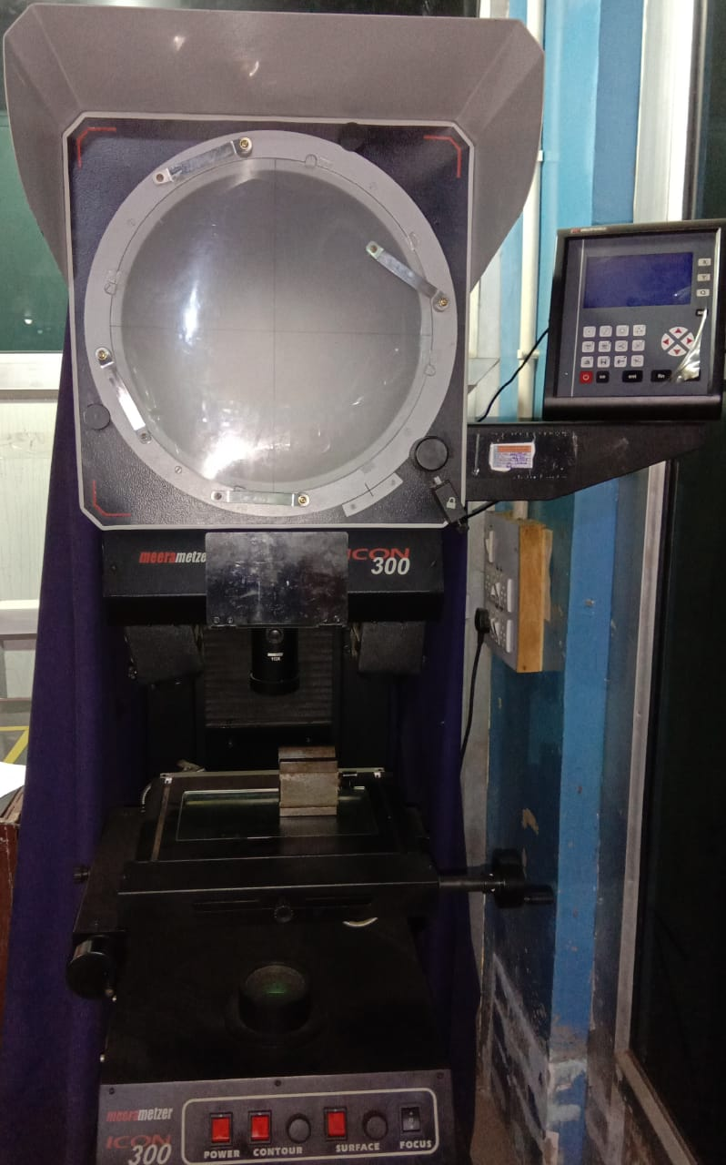
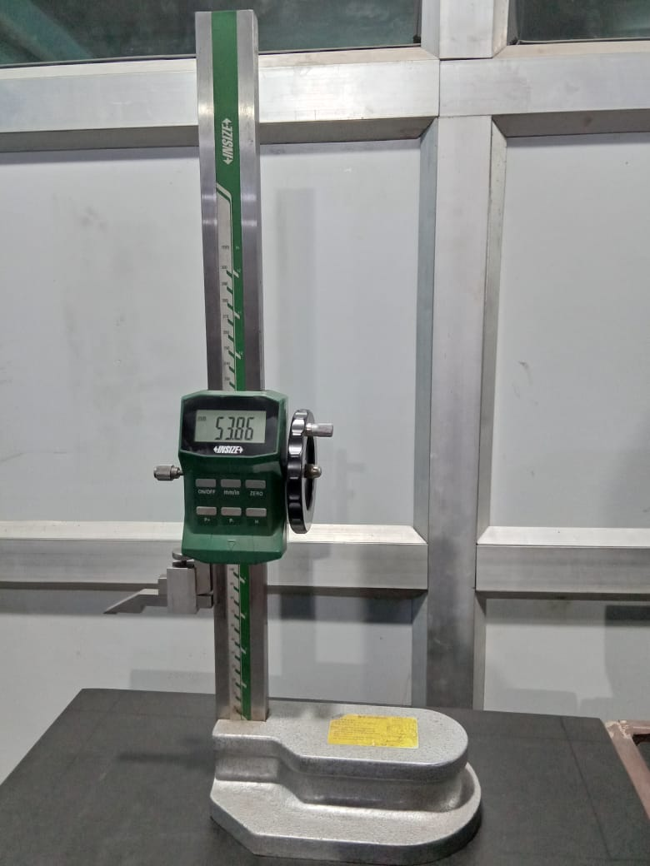
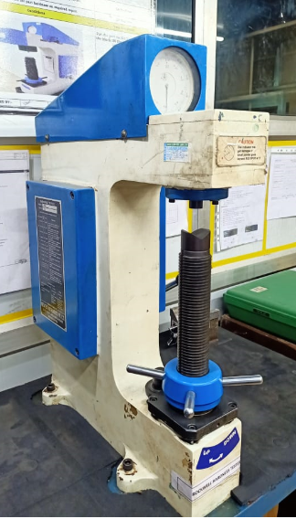
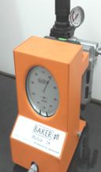
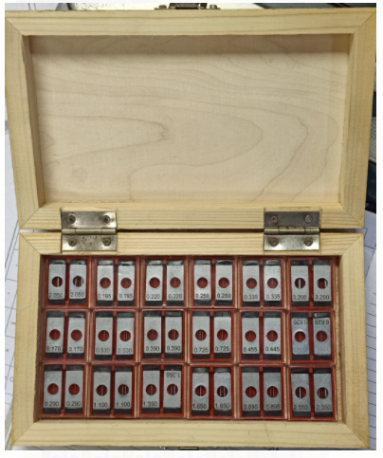
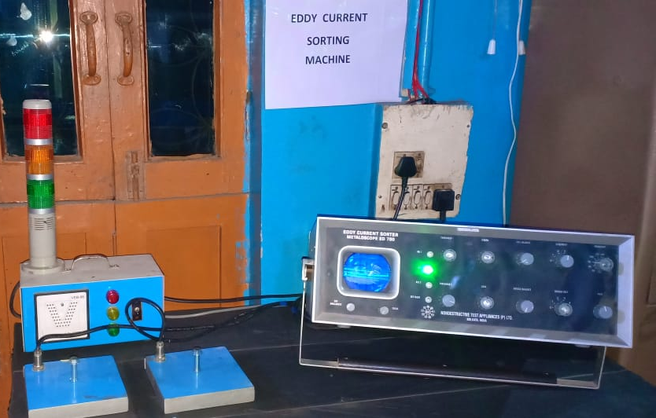
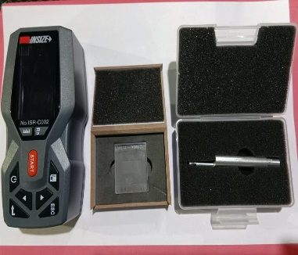
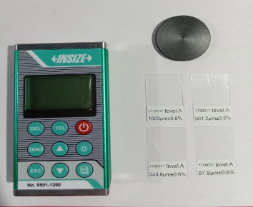
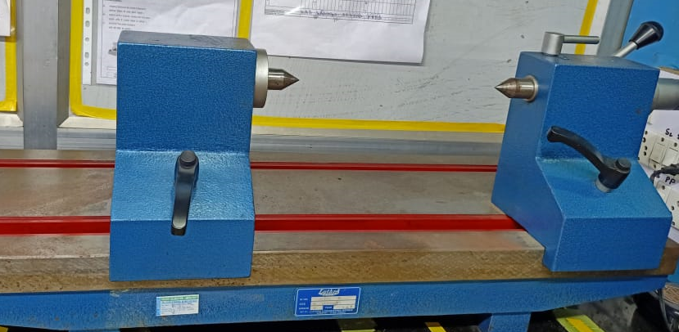
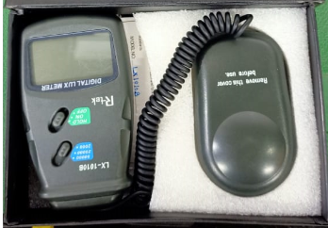
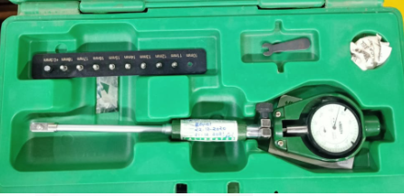
Inspection Facilities
Profile Projector
Digital Height gauge
Hardness Tester
Air Gauge Unit
3 Pin wire Set
Eddy Current Shorting
Roughness Tester
DFT Tester
Bench Center
Lux Meter
Bore Gauge
Digital Micrometer
Surface Plate
Angle Protector
Digital V.C.

Slide 36
Ultrasonic Cleaning Machine
Spectro ( Chemical Testing Machine )

Slide 37
List of Instruments Platting Plant
S.S.T. Chamber.
Hot Plate.
Laboratory Rectifier.
Hull Cell.
T.D.S. Meter.
Laboratory Weighing M/C.
Microscope.

Slide 38
Inspection Facilities
SST Chamber
Laboratory Rectifier
Hot plate
Hull Cell
TDS Meter
Weigh Scale

Slide 39
DOZO ROOM FOR TRAINING OF NEW EMPLOYEE AND REGULAR EMPLOYEE

Slide 40
Final Inspection
100% Final Inspection to achieve zero rejection at customer end- There is separate tables for separate material in which we have made the separate section in the tables for OK material, Re-work material and Reject material. All final inspection is carried out on these tables.
Table for final inspection
Separate tables for all parts during final inspection

Slide 41
To create awareness about Quality ,we conducted training programs
Quality Month celebration.
Speech on Moral Values etc.

Slide 42
Future plans
Increased turnover by 200% up to 2023.
Add Part farmer M/c (Capacity NF-11 B) Up to Dec.2023.
Add Part farmer M/c (Capacity NF-19 B) Up to Apr.2024.
Bolt maker M8 machine up to April 2024.
Bolt Maker ½ inch machine up to Aug. 2024.
Add in future Automatic bin Cleaning machine Mar.2024
Add in Future XRF for checking of plating thickness. Mar.2024
Add in future Contracer Machine for inspection Mar.2024
Add in future plating plant fully Automatic Apr.2024
Establish Unit -2 Apr.2024

Slide 43
THANKS
Contact US :
PLOT NO. 24,
NEAR JIND RAILWAY CROSSING FLYOVER,
ROHTAK (HARYANA) - 124001, INDIA.
E-mail :- virenderhooda@nirmalautotech.com
Website : www.nirmalautotech.com
Mob: +91-9992009744, +91-9315349744

